Slide 1

EUROPEAN SOCCER ANALYTICS
Group Members:
Abhinandan Sampathkumar Prathik Rokhade Venkat Sambandhan

Slide 2

Introduction:
Leagues
        EPL, Bundesliga, La Liga, Serie A
Tournaments
        FA Cup, UEFA, Europa, Euros
Clubs
        Real Madrid, Barcelona, Bayern Munich, Arsenal
Transfer Window
        Winter and Summer

Slide 3

Soccer Dataset
Kaggle
+25,000 matches
+10,000 players
Seasons 2008 to 2016
Detailed match events (goal types, possession, corner, cross, fouls, cards etc...) for +10,000 matches

Slide 4



Clients and Users

Slide 5

Goals and Objectives
Identify the most predictable league in Europe.
Top N players of Europe.
Provide Visualizations to make better decisions.
Beta-interactive setup.

Slide 6

Tools and Technologies:
R
Python
JDBC SQLite Drivers
SQLite
Anaconda

Slide 7
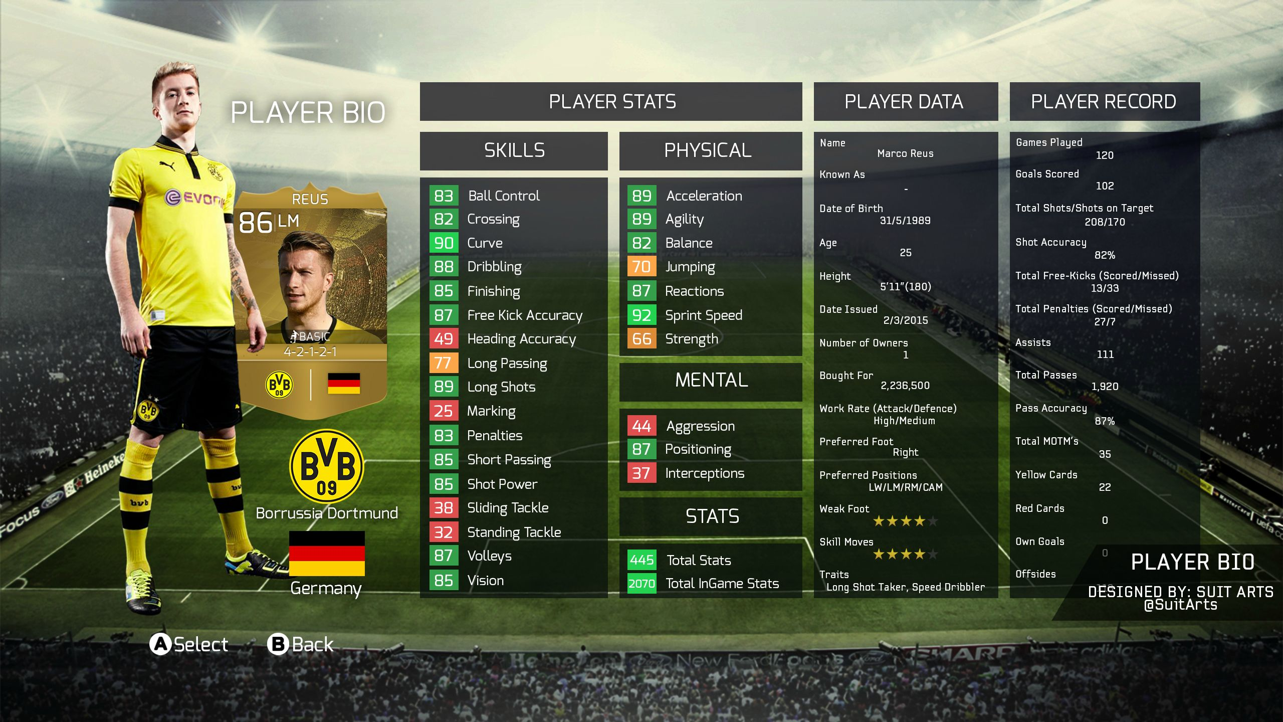
Tables

Slide 8
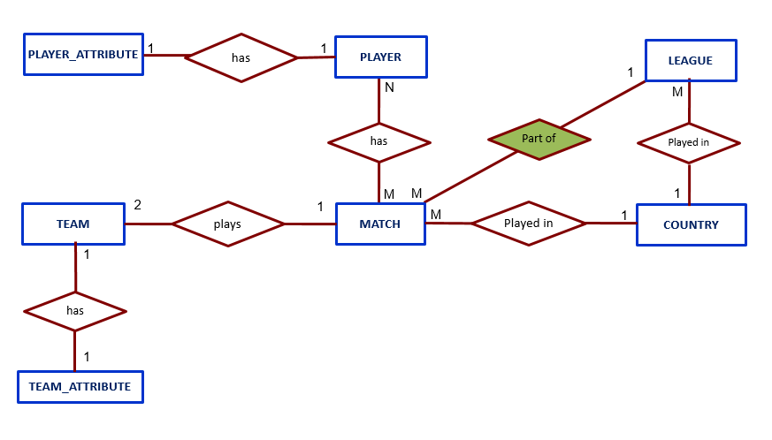
E-R Diagram

Slide 9
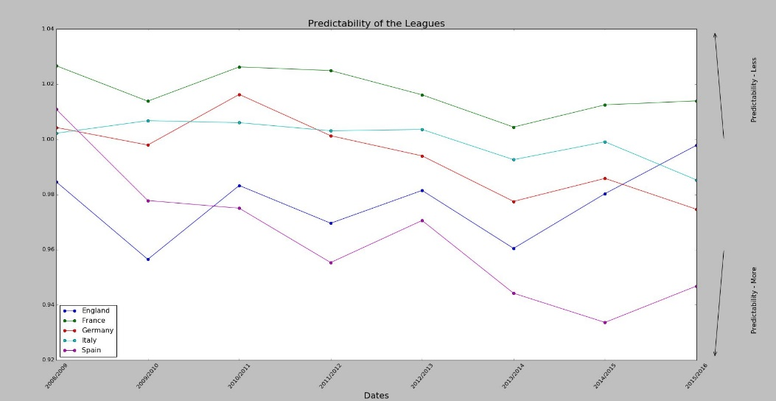
Goal 1: Identifying most predictable league
Using Python, the probability and mean entropy was calculated to predict the leagues. The result was plotted as below.

Slide 10
Goal 2: Top N Players
Using Python, the top 20 players were calculated by taking the average of any specific parameter over all the matches recorded, in the ‘player_attributes’ table and sorting it in descending order.

Slide 11
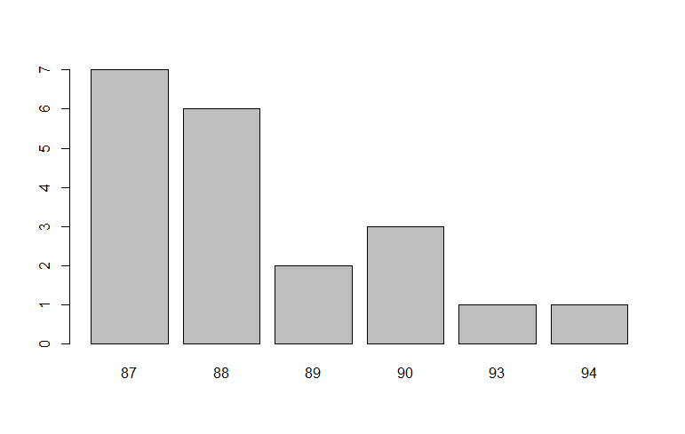
Frequency Bar Plot

Slide 12
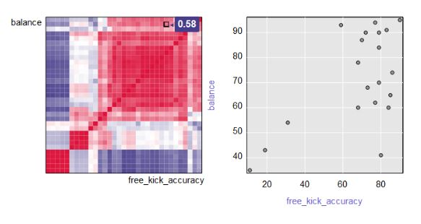
Correlation Matrix

Slide 13
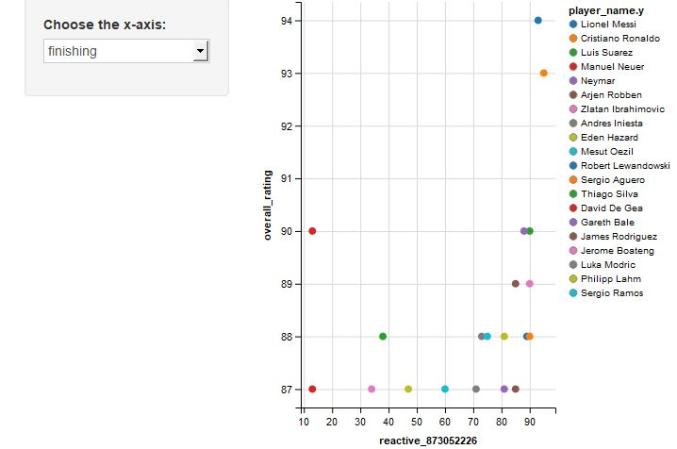
Scatter Plot

Slide 14
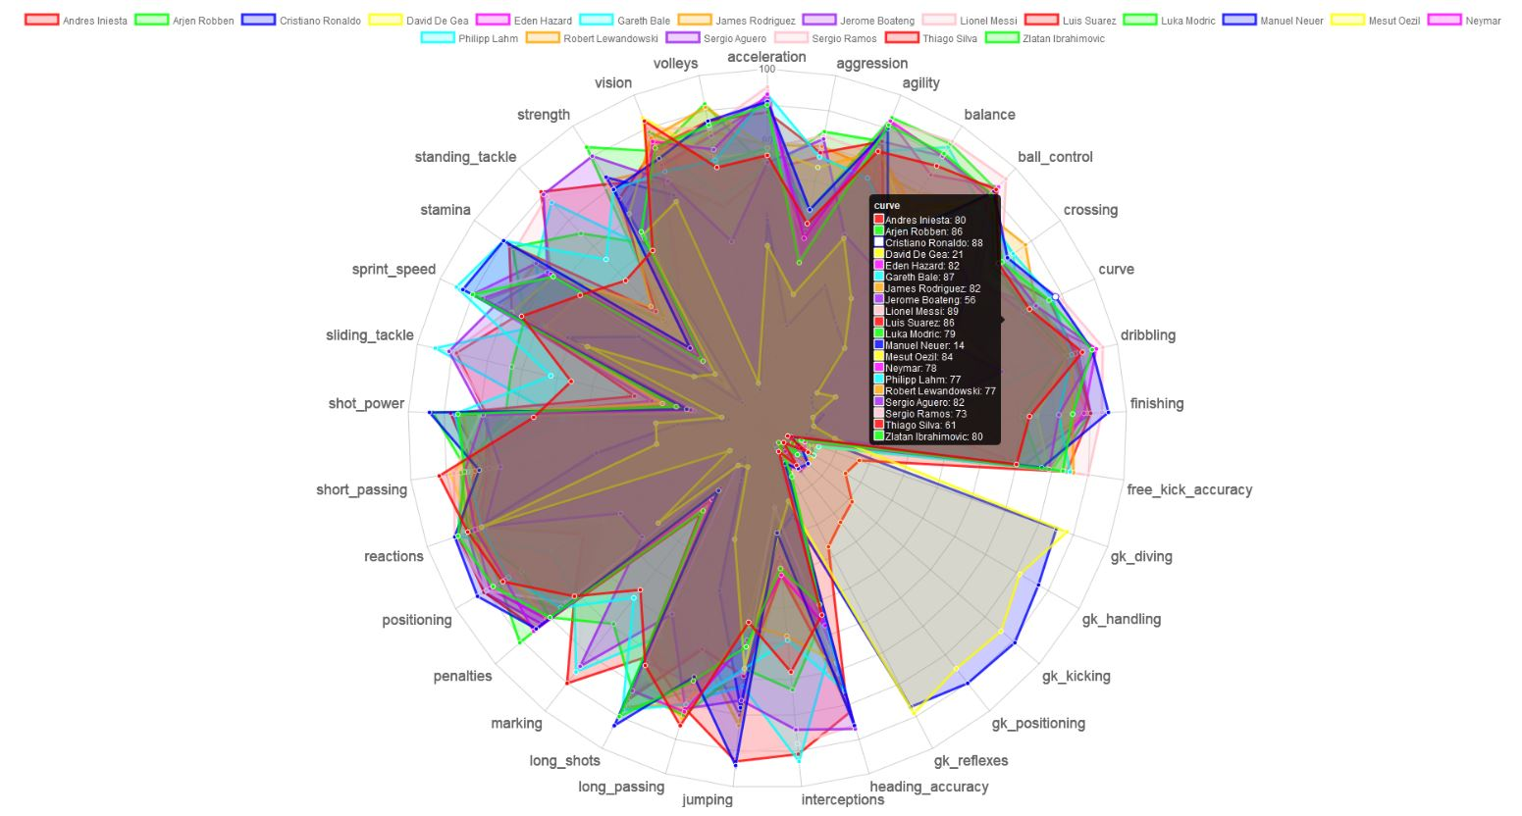
Goal 3: Attribute Radar Chart

Slide 15

Future Work
Optimize dataset by normalization without any loss of data.
Provide admin rights using sophisticated encryption keys or RSA.
Develop a web-app using duo authentication.
Implement an interactive UI.
Embed high charts and advanced plugins.

Slide 16
THE END

Slide 17


